Slide 1
Chapter 14
Social Relationships
Notes:
Add slide notes here

Slide 2
The Family as a System within Systems (1 of 2)
Difficult to define family to describe across all cultures and eras
Proponents of family systems theory conceptualize family as a system
  Dynamic
    A self-organizing system that adapts itself to changes in its members and to changes in its environment
  Embedded in and interacts with larger social systems neighborhood or a community

Slide 3
The Family as a System within Systems (2 of 2)
Family systems theory: The family is a whole consisting of interrelated parts, each contributing to the whole.
  Nuclear family. Consists of father, mother, and at least one child, now called the “immediate family”
  Alloparenting. Parenting by multiple caregivers
  Extended family household: In which parents and their children live with other kin (grandparents, aunts, uncles, etc.)

Slide 4
A Changing System in a Changing World (1 of 3)
Trends in the United States
  More single adults
    Never married—20% of adults age 25 and older
  More postponed marriages
    1960—age 20 for women, 23 for men; 2019—age 28 for women, 30 for men
  More unmarried parents
    40% of births in 2017 were to unmarried women
  Cohabitation: Living with a romantic partner without being married has been steadily increasing

Slide 5
A Changing System in a Changing World (2 of 3)
Trends in the United States
  Fewer children
  More working mothers
    1950—12%; 2019—66%
  More divorce
    Over 40% of newly married couples can expect to divorce
  More single-parent families
    In 2018 up to 22% younger than 18 lived with their mother only, 4% with fathers, and 4% with nonparents

Slide 6
A Changing System in a Changing World (3 of 3)
Trends in the United States
  More remarriages
  Older women are more likely than older men to live alone rather than with a spouse (36% vs. 20%)
  More multigenerational families
  8% of children live with grandparents in the home, 30% expected to do sometime during childhood
  Fewer caregivers of aging adults

Slide 7
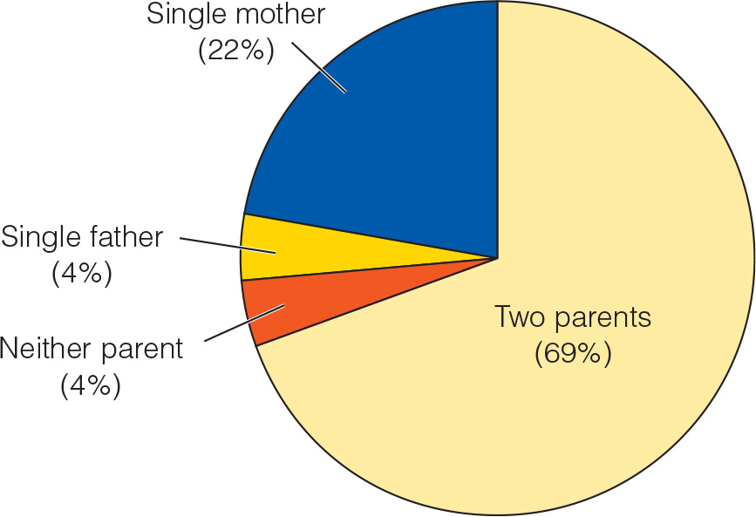
A Changing System in a Changing World (Children From Birth to Age 17)
Notes:
Figure 15.1 Percentage of children from birth to age 17

Slide 8
Mothers and Fathers (1 of 2)
Researchers repeatedly find that fathers and mothers are similar in caring for infants
  Able to feed their babies effectively
  Provide sensitive parenting
  Become objects of attachment
  Mothers spend more time directly caring for infants

Slide 9
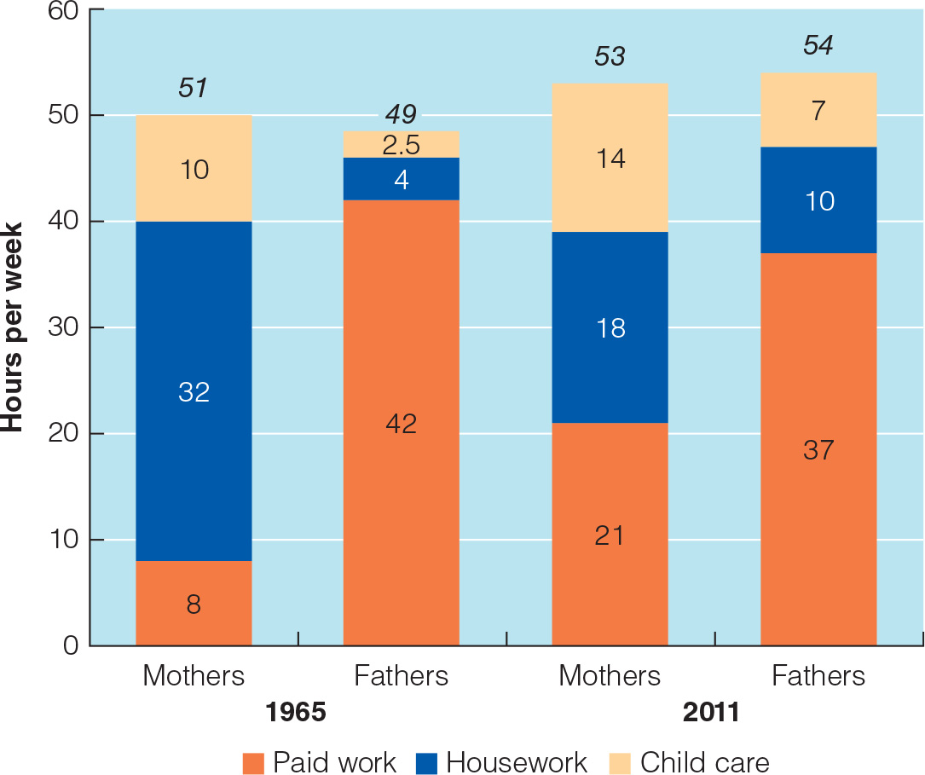
Mothers and Fathers (2 of 2)
Notes:
Figure 15.2 Changes in time use of mothers and fathers between 1965 and 2011

Slide 10
Parenting Styles (1 of 2)
Two dimensions of parenting
  Parental acceptance−responsiveness (Warmth)
    Extent to which parents are warm, supportive, and sensitive to their children’s needs
  Demandingness (Control)
    How much control over decisions lies with the parent as opposed to with the child

Slide 11
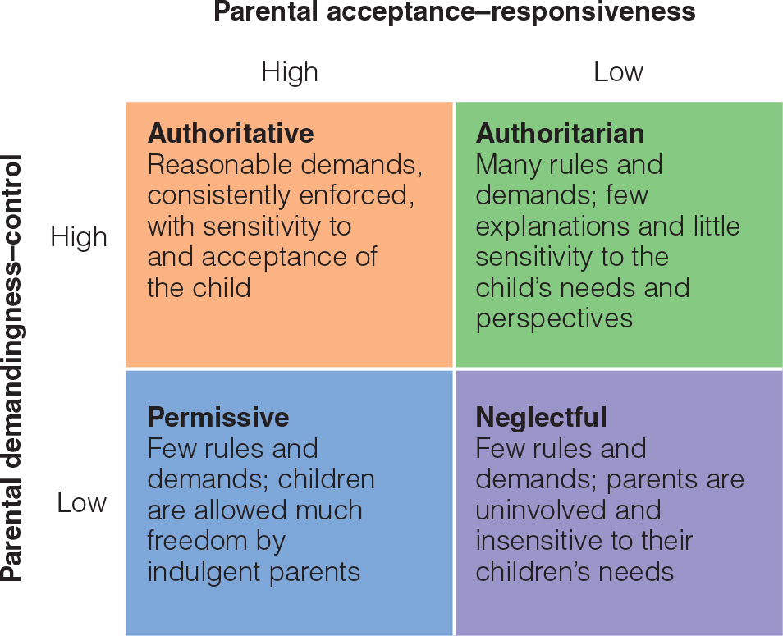
Parenting Styles (2 of 2)
Notes:
Figure 15.3 The acceptance–responsiveness and demandingness–control dimensions of parenting

Slide 12
Models of Influence in the Family (1 of 2)
Parent effects model of family
  Influences run one way, from parent (particularly mother) to child
Child effects model of family influence
  Highlights the influences of children on their parents

Slide 13
Models of Influence in the Family (2 of 2)
Interactional model
  Recognizes that parent and child characteristics may combine in certain ways to influence development
  Gene−environment interaction
Transactional model of family influence
  Parent and child are seen as influencing one another reciprocally over time.

Slide 14
Sibling Relationships (1 of 2)
Arrival of a sibling
  Most adjust well
    60% of firstborns coped well
    31% found the experience threatening
  Temporary decreases in children’s affection for and responsiveness to their mothers

Slide 15
Sibling Relationships (2 of 2)
Four functions of siblings
  Emotional support
  Caregiving
  Teaching
  Social experience
Indirect effects
  Older competent sibling → mother’s positive psychological functioning → supportive parenting → competent younger sibling

Slide 16
Ripples in the Parent‒Child Relationship
Most parent‒child relationships are close
  Do change during adolescence
  Conflict increases temporarily during puberty
    Mainly about minor matters, such as homework, chores, and disobedience
  Adolescents spend more time with peers.

Slide 17
Achieving Autonomy
Key developmental task during adolescence
  Achieving autonomy
  Adolescents in both individualistic and collectivist cultures strive for autonomy.
Authoritative parenting style
  Gives adolescents opportunities to strengthen their independent decision-making skills while retaining the benefit of their parents’ guidance
  Helicopter parenting style. Overparenting, involves developmentally inappropriate levels of control and assistance

Slide 18
Singles
Majority of adults are unmarried.
  Run the risk of being lonelier than most adults in later life
Reasons for cohabitation
  Convenience
  Trial marriage
  Alternative to marriage
Adults who are single by choice are self-supporting and are satisfied with their lives.

Slide 19
Establishing a Partnership
Between 80 and 90% of adults choose to marry at some point. However, the percentage of adults living with a spouse has fallen.
First year of marriage
  Perceptions of the marital relationship less favorable
  Marital satisfaction declines
Couples most likely to survive when they maintain a high level of positive and supportive interaction

Slide 20
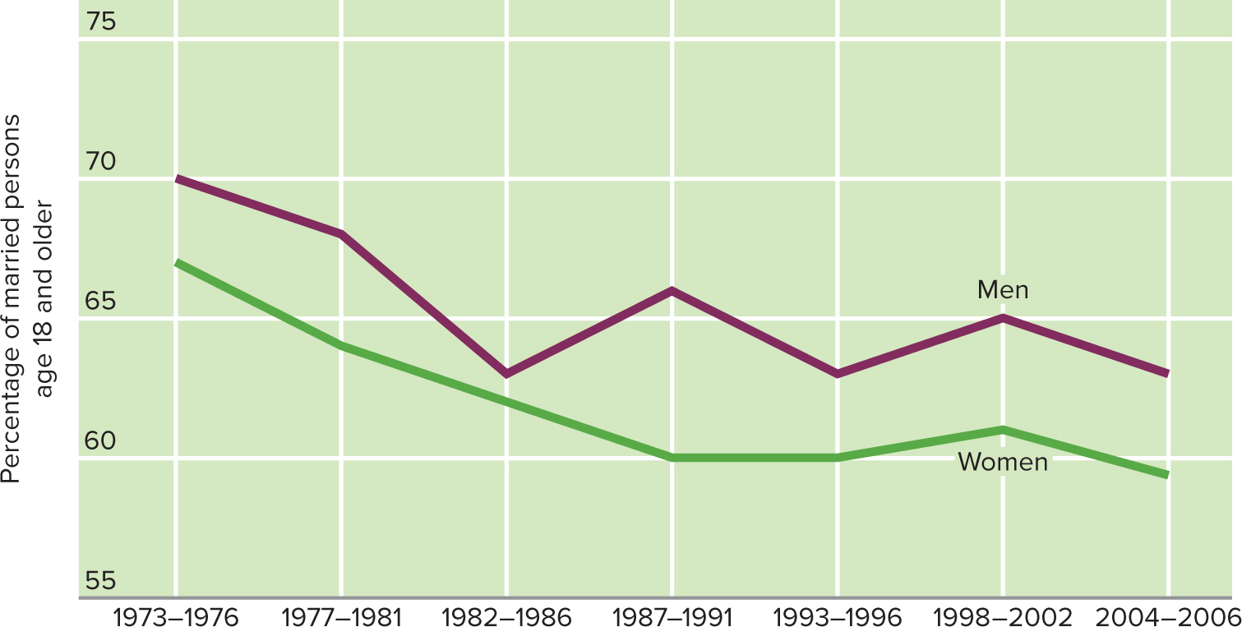
Percentage of Married Persons Age 18 and Older with “Very Happy” Marriages

Slide 21
Divorcing Families (1 of 2)
Couples at highest risk for divorce
  Younger (20s and 30s)
  Married for an average of only about seven years
  Have young children
These couples feel their marriages lack communication, emotional fulfillment, or compatibility

Slide 22
Divorcing Families (2 of 2)
Divorce is typically a one- to two-year crisis
Divorced adults are at higher risk for:
  Depression
  Psychological distress
  Physical health problems
  Even death

Slide 23
Reconstituted Families
Within three to five years after a divorce, 75% of single-parent families acquire a stepparent
About 60% of remarried couples divorce
  Recurring cycles of singlehood, cohabitation or marriage, conflict, and separation or divorce
One-third of adults find remarriage more stressful than divorce.

Slide 24
Childless Married Couples
Childlessness does not diminish the well-being of adults
  Sometimes boosts it
    Marital satisfaction higher than couples with children during childrearing years
Children do not guarantee happiness; not having children does not mean unhappiness.

Slide 25
New Parenthood
By age 40 to 44
  85% of women in the United States have given birth to a child
  80% of men have fathered a child
New parenthood is a stressful transition
  Parents who cope adaptively
    Have an easy baby
    Possess positive personal qualities and coping skills
    Receive reliable support from their partners

Slide 26
The Childrearing Family
Children have a slightly negative effect on marital satisfaction
  Stress of parenting
  Claims energy from marital relationship
Parents
  Emphasize the positives about parenthood
  Feel it has contributed a great deal to their personal development

Slide 27
The Empty Nest
Parents react more positively than negatively to children leaving home
  Fewer roles and responsibilities
  More opportunity to focus on their marital relationship
  Evidence they have done their job as parents
Boomerang Children
  In recent years, an increasing number of young adult children remain in the nest or come back
  Over 30% of people aged 18 to 34 live with parents.

Slide 28
Changing Responsibilities
Caring for aging parents
  Middle generation squeeze: To describe the situation of middle-aged adults pressured by demands from other generations
  Traditional gender roles call for women to be “kinkeepers”
  Caregiver burden: Psychological distress associated with the demands of providing care for someone with impairments

Slide 29
Grandparenthood
Three major styles of grandparenting
  Remote
    Geographically and emotionally distant
  Companionate
    Most common style
    See grandchildren frequently, enjoy activities with them
  Involved
    Often help with child care, give advice, and play other practical roles in their grandchildren’s lives

Slide 30
Relationships in Older Adulthood
Disengagement theory: incorrect belief that older adults disengage from society—and society disengages from them—as they anticipate death.
Activity theory: reductions in social interaction as an involuntary result of social barriers to engagement.
Socioemotional selectivity theory: with age, information-sharing aspects of social interaction are less important than emotion-regulation aspects.
Notes:
LO 14-5: Examine changes in social relationships change over the lifespan.
D. Older Adult’s Changing Social World
a. Disengagement Theory
i. Disengagement theory: a commonly held, though incorrect, belief
that older adults disengage from society—and society disengages from them—as they anticipate death
b. Activity Theory
i. Activity theory: the assertion that reductions in social interaction
as an involuntary result of social barriers to engagement
ii. Older adults replace lost social roles to stay active, busy, and
healthy (require quality activities, such as volunteering)
iii. People are motivated to adapt as needed to maintain a sense of
continuity, and older adults tend to seek routine
c. Socioemotional Selectivity Theory
i. With age, information-sharing aspects of social interaction are less
important than emotion-regulation aspects
ii. As perceived time left diminishes, adults become increasingly
motivated to derive emotional meaning and cultivate emotionally close relationships

